Slide 1

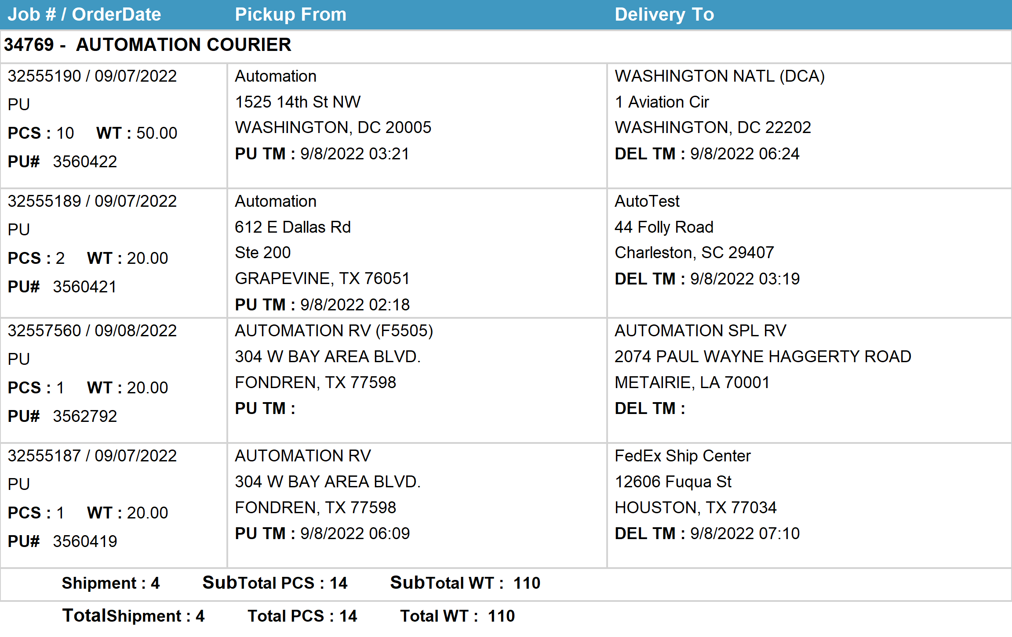
Agent Activity Report
*Data provided should be considered CONFIDENTIAL and PROPRIETARY*
©2011-2022 MNX Global Logistics. All rights reserved.
9/8/2022 4:57 AM
Print User : automation

